Slide 1
Next Up:
Emrys MacInally

Slide 2
3
3

Slide 3
2

Slide 4
1

Slide 5
Versioning your PowerShell Modules
Emrys MacInally

Slide 6
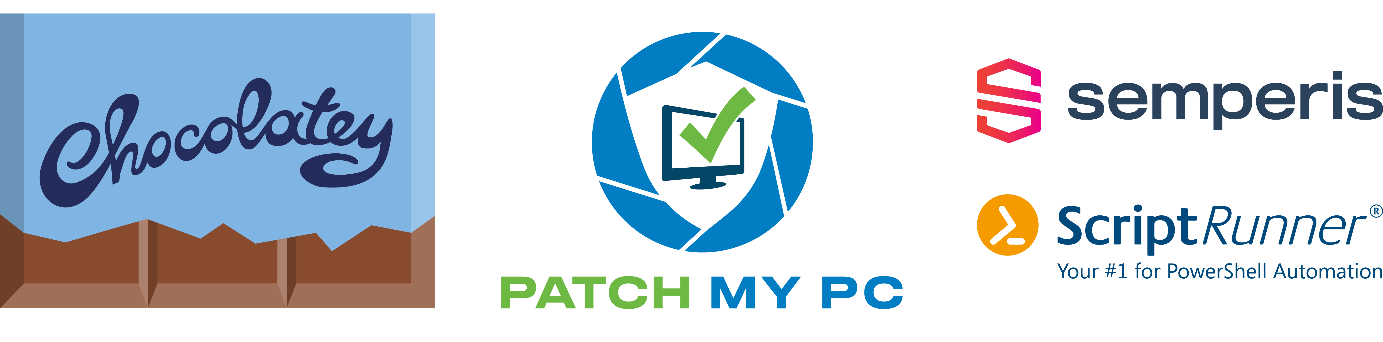
Many thanks to our sponsors:

Slide 7


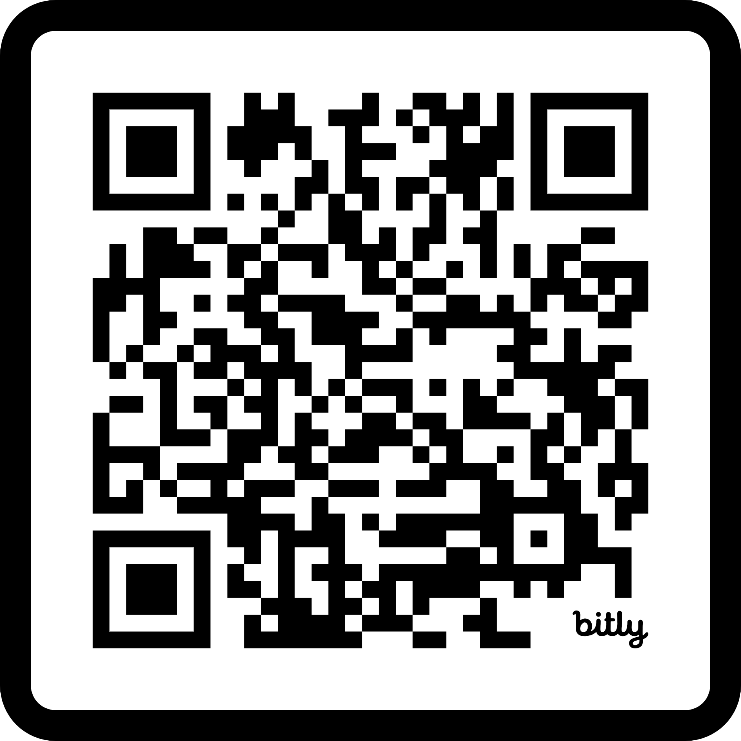
Emrys MacInally
Team Lead Deployment & Automation @ medavis
Working in IT for 19 years
Fell in with PowerShell 15 years ago

Slide 8
Contents
What is versioning
Versioning schemes
Semantic versioning
Versioning in PowerShell
Gitversion

Slide 9
What this talk is ...
..about
Versioning PowerShell modules
... not about
Module templating
Build pipelines

Slide 10
What is Versioning
“Assigning unique identifiers or numbers to different versions of software, documents, or products.”
Track changes, updates, and revisions over time.
Understand the evolution of the product.
Manage compatibility between different versions.
Each version represents a distinct stage in development

Slide 11
Versioning Schemes
Versioning Examples:
Sequential numbering: Version 1, Version 2, Version 3
Date-based versioning: 2022-01-01, 2022-02-15
Internal build numbers: Build 1001, Build 1002, Build 1003
Major/minor versioning: 1.0, 1.1, 2.0
Semantic versioning

Slide 12
Semantic versioning
Widely adopted versioning schema in many programming languages
Helps users and developers predict the impact of new software releases
Consists of three numbers MAJOR.MINOR.PATCH

Slide 13
Semantic versioning
Major 1.0.0
version when you make incompatible API changes
Minor 1.1.0
version when you add functionality in a backward compatible manner
Patch 1.1.1
version when you make backward compatible bug fixes

Slide 14
Semantic versioning (optional)
prerelease - 1.0.0-alpha1
Indicates that the version is not final
Prerelease identifier comes after PATCH and begins with a '-’
Prerelease versions precede the final, stable release of a software product
[0-9A-Za-z-]
build metadata - 1.0.0-alpha1+sha1.1a2b3c4
Additional information about the build (e.g. commit hash or environment information)
Comes directly after PATCH or prerelease and begins with '+’
Ignore build metadata for version precedence
[0-9A-Za-z-]

Slide 15
Versioning in PowerShell
PowerShell supports
MAJOR, MINOR (1.0)
MAJOR, MINOR, PATCH (1.0.1)
MAJOR, MINOR, PATCH, BUILD (1.0.2.3)
Must be MAJOR, MINOR, PATCH if you want to use prereleases
(.) and (-) not allowed in prerelease with PowerShellGet
No Metadata support with PowerShellGet

Slide 16
Demos
We love Demos!

Slide 17
Gitversion
Generates Semantic Version numbers based on your Git history
Used for stamping version numbers on artifacts produced during build
Highly configurable
Supports many git branching strategies

Slide 18
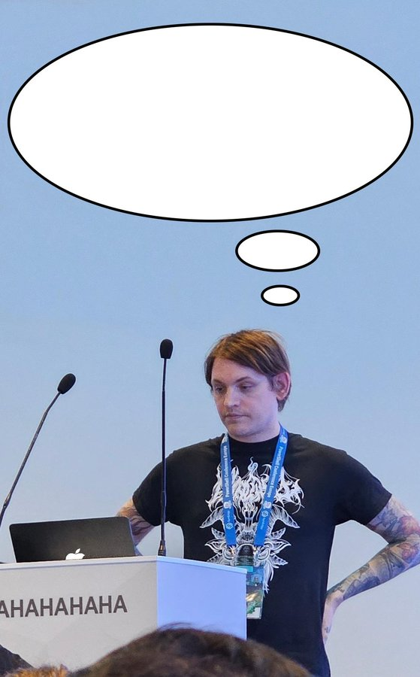
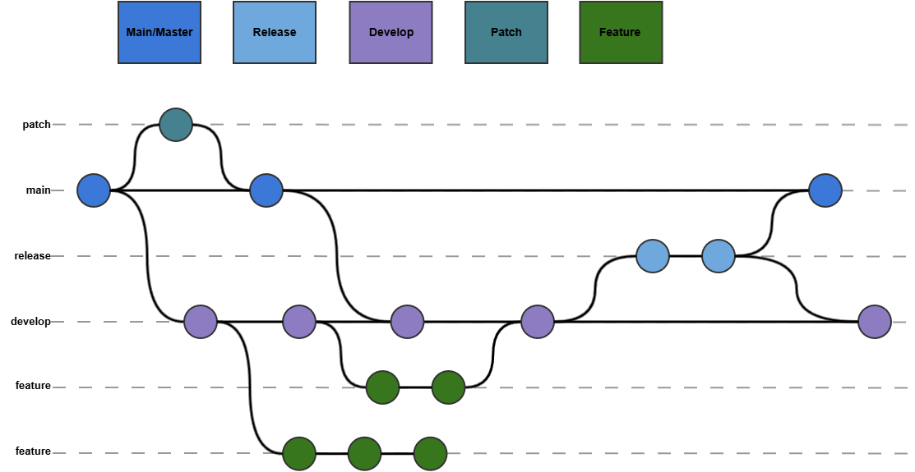
Gitflow
That’s way to complicated for me

Slide 19
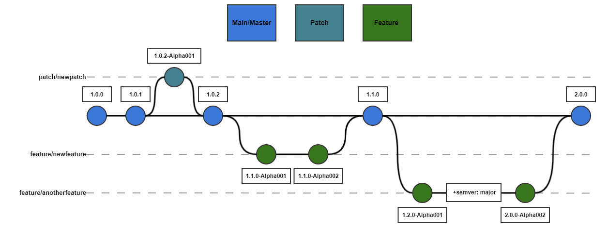
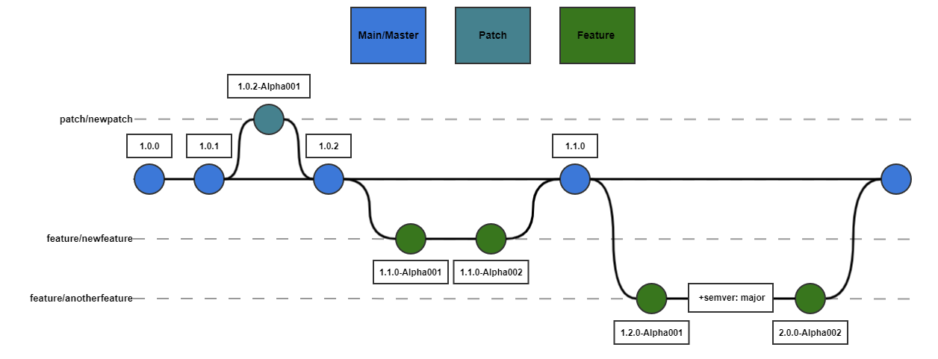
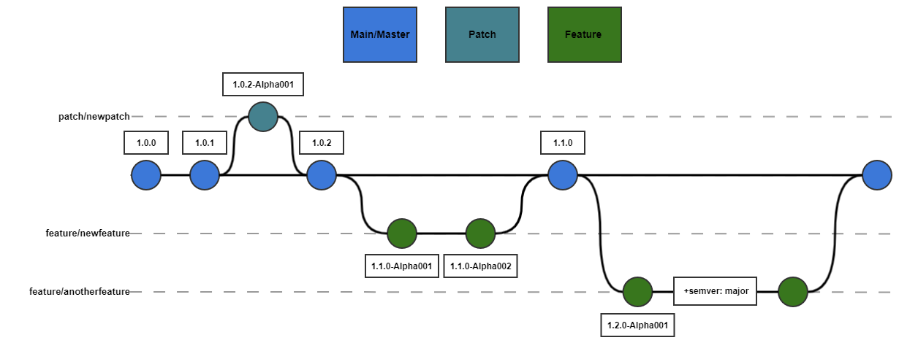
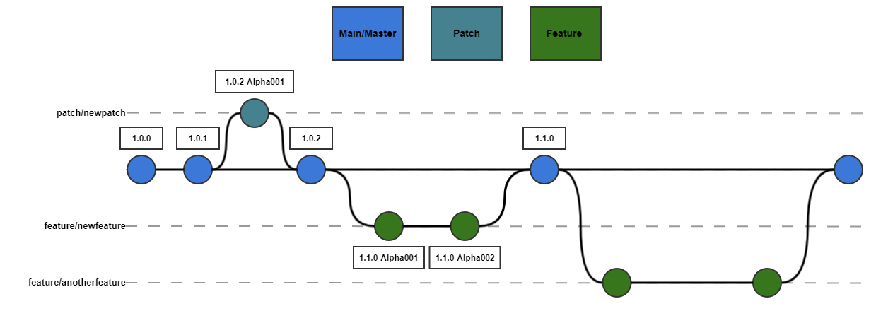
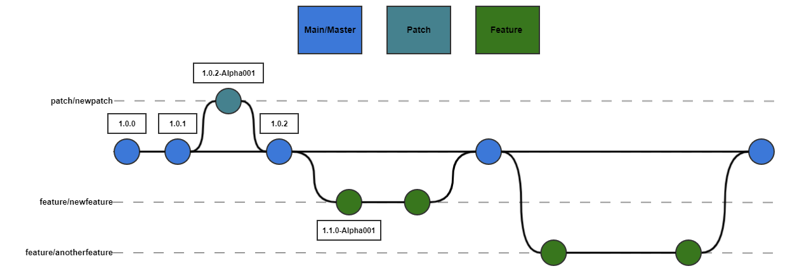

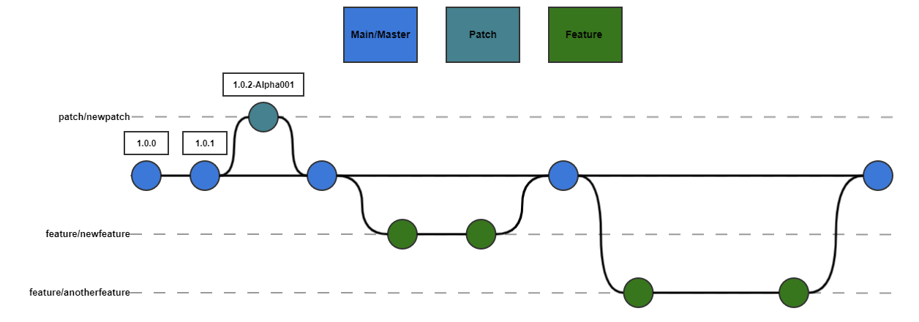
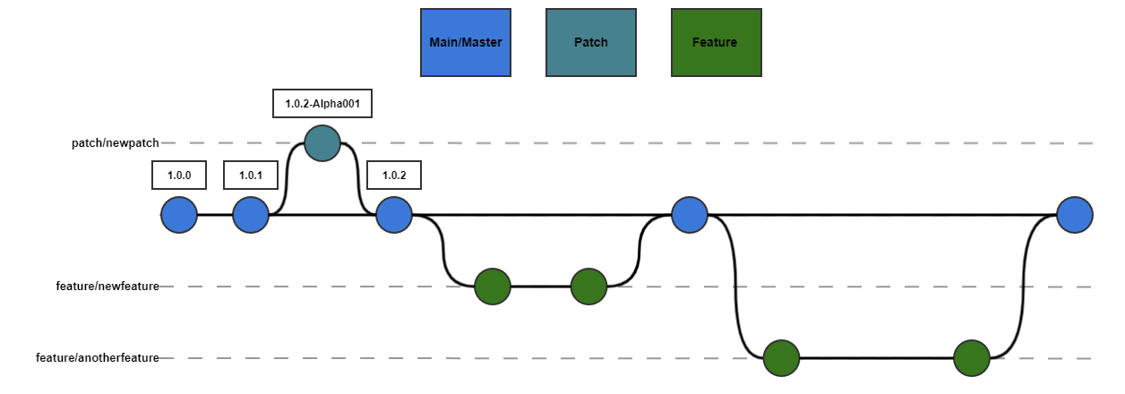
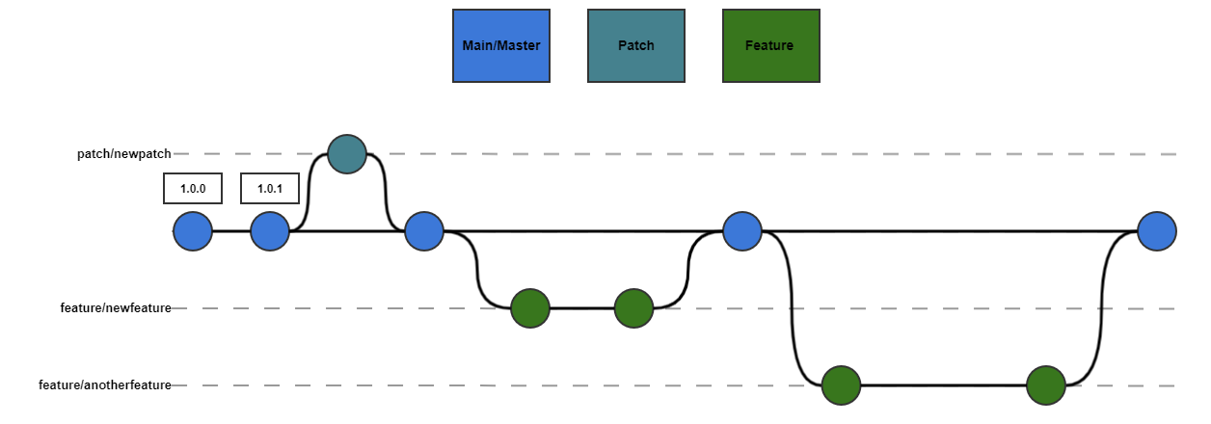
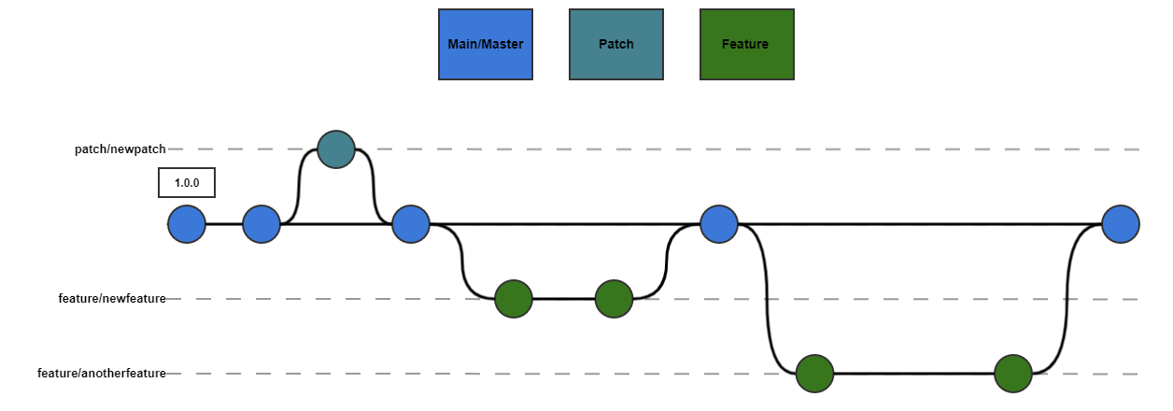
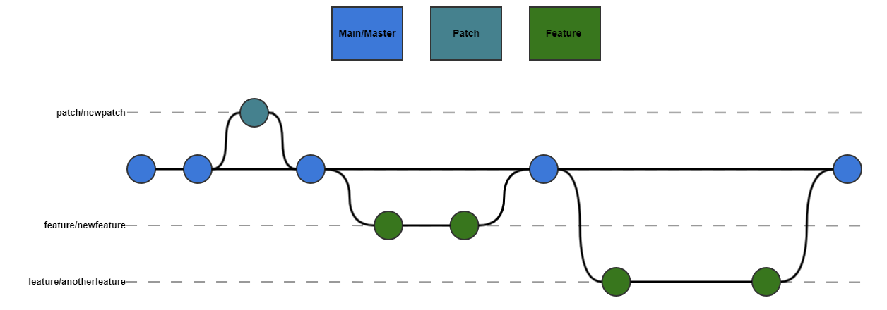

Trunk-based development

Slide 20
Demos
We love Demos!

Slide 21
Conclusion
Use semantic versioning
When versioning your modules use the method that works for you
Take versioning seriously, but not too seriously

Slide 22
Q&A
15 minutes

